Slide 1

CSS

Slide 2
What is CSS?
CSS is a style sheet language that’s focused entirely on improving the presentation of HTML elements. While CSS is a static markup language, it can be used to make your website appear visually pleasing and modern.

Slide 3
Focus points:
Selectors
Properties
Cascade of CSS
Adding CSS to HTML
Box Model
Display property
Flexbox

Slide 4
How does CSS work?
At the most basic level, CSS is just a set of rules you declare that represents how the browser should interpret the visual appearance of HTML elements.
Each rule is made up of selectors and declarations where each declaration is made up of a property:value pair.

Slide 5
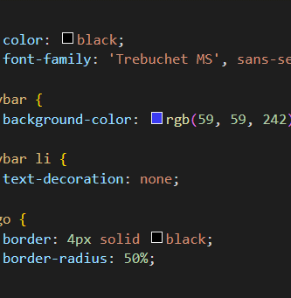
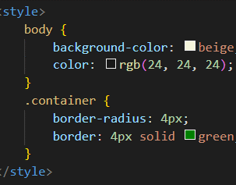
Selectors
CSS

Slide 6
Selectors
Selectors simply refer to which HTML elements the given rules apply. There are many types of selectors that we will cover so that we could find the easiest way to select HTML elements that we want to:
Universal selectors
Type selectors
Class selectors
ID selectors
Grouping selectors
Chaining selectors
Descendant combinator

Slide 7
Universal Selectors
The universal selector selects elements of any type, hence its name. The syntax for it is the asterix sign ‘*’. The example in the image would give all elements in the HTML page the color red.

Slide 8
Type Selectors
The type selector (also known as ‘element selector’) will select all the elements of the given type. The syntax for it is the name of the element without the angle brackets. The example in the image would color all the paragraphs yellow.

Slide 9
Class Selectors
The class selector will select all elements with the given class. That given class is just an attribute you place in the opening tag of the HTML element (ex.: <p class=”myClass”>). The syntax for class selectors is a period ‘.’ followed by a case-sensitive value of the class attribute. The example in the image would color all elements with the class name ‘myClass’ green.

Slide 10
Class Selectors
Classes aren’t meant to be unique, which means that you can apply the same class on as many elements as you want, each of them will be affected by the same CSS declaration you have given. You can also apply more classes to a single element.

Slide 11
ID Selectors
ID selectors are similar to class selectors. They select an element with the given ID, which is another attribute you place on an HTML element (ex.: <p id=”myID”>). The difference between IDs and classes is that an element can have only one ID, while elements can have many classes. The syntax for ID selectors is a hashtag sign ‘#’ followed by a case-sensitive value of the id attribute. The example in the image would color only the one element that has the given ID attribute.

Slide 12
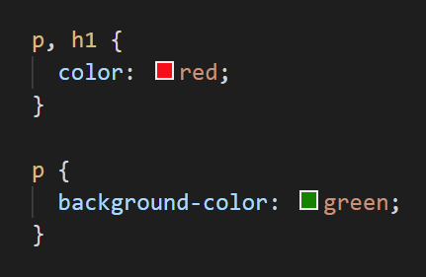
Grouping Selectors
Grouping selectors will select multiple groups of elements which share the same style declarations. They are very useful as they shorten the amount of code you need to write, modify or read. The syntax for grouping selectors is simply a comma between each of the selectors you wish to apply the ruleset to. The example in the image would color paragraphs and headings red, but the paragraphs would have a green background color.

Slide 13
Chaining Selectors
Chaining selectors is a way to select elements that correspond to the multiple selectors given. The syntax for it is just combining the multiple selectors with no whitespace between them. The example would color purple only paragraphs with the class ‘myClass’, all other paragraphs or elements with the class name myClass will be colored black.

Slide 14
Chaining Selectors
You can’t chain more than one type selector as elements can’t be more than one type as you can see in the example. However, you can chain an infinitely long chain of other selector types. Note that if it’s infinitely long, there’s probably a better way to select the elements you need.

Slide 15
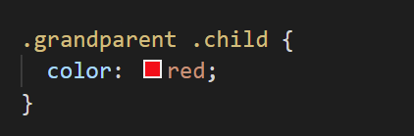
Descendant Combinator
Combinators allow us to combine multiple selectors differently than either grouping or chaining them, as they show a relationship between the selectors. Descendant combinators are represented by a single space between selectors. A descendant combinator will only cause elements that match the last selector to be selected if they also have an ancestor (parent, grandparent, etc.) that matches the previous selector. For example if our selector is .grandparent .child then our .child will be affected by given CSS rules only if it’s nested inside of .ancestor, no matter how deep it’s nested.

Slide 16
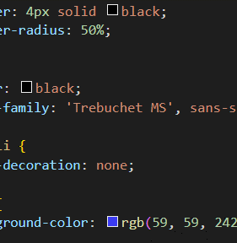
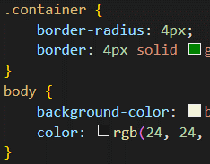
Properties
CSS

Slide 17
Properties
Properties are the styling rules that we apply to the elements that we have selected. They are in the shape of property:value. Here are a few commonly used properties which we will cover:
color and background-color
font-family, font-size, font-weight and text-align
height, width, border-radius

Slide 18
Color property
The color CSS property sets the foreground color value of an element's text and text decorations.

Slide 19
Background-color property
The background-color CSS property sets the background color value of an element.

Slide 20
Color values
Both color and background-color can accept different kinds of values, a common type that we’ve shown is using a keyword for an actual color name (red, green, yellow). Other types are HEX, RGB and HSL values. In the example you can see 4 ways to display the color red.

Slide 21
Font-family
font-family property can be a single value or a comma-separated list of values that determine what font an element uses. Each font will fall into one of two categories, either a “font family name” like "Times New Roman" (we use quotes due to the whitespace between words) or a “generic family name” like sans-serif (generic family names never use quotes).

Slide 22
Font-family
If a browser cannot find or does not support the first font in the list, it will try to use the next one, and the next one until it finds a specified font that it can support. This is why it’s good practice to include a list of fonts rather than just one font, starting with the font you want to be used most, and ending with a generic font in case all previous fail.

Slide 23
Font-size
font-size property affects the size of the font. When setting the value to this property, there should be no whitespace between the amount and the unit (16px instead of 16 px).

Slide 24
Font-weight
font-weight property affects the boldness of text if the fonts support the specified weight. Its value can be a keyword (thin, normal, bold) or a number between 1 and 1000.

Slide 25
Text-align
text-align property will align text horizontally within an element, and it’s value is one of the following common keywords:
left (default value, content aligns along the left side)
right (content aligns along the right side)
center (content aligns in the center, whitespace should be equal on left and right side)
justify (distribute your text evenly between the edges)
inherit (its value will be whatever its parent elements is)

Slide 26
Image properties height & width
By default, an <img> element's width and height values will be the same as the actual image file’s width and height. If you wanted to adjust the size of the image without causing it to lose its proportions, you would use a value of “auto” for the height property and adjust the width value.
It’s best to include both of these properties for <img> elements, even if you don’t plan on adjusting the values from the image file’s original ones. When these values aren’t included, if an image takes longer to load than the rest of the page contents, the image won’t take up any space on the page at first, but will suddenly cause a drastic shift of the other page contents once it does load in. Explicitly stating a height and width prevents this from happening, as space will be ‘reserved’ on the page and will just appear as a blank space until the image loads.

Slide 27
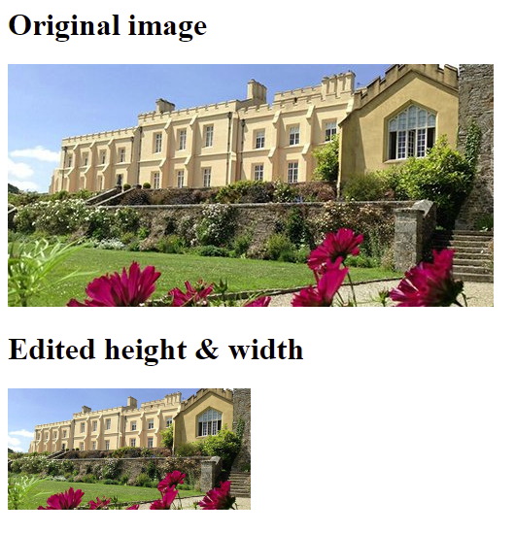
Image properties height & width
The first image (original) has no CSS applied to it, and has it’s original dimensions set (500px by 250px). In the second image we have edited the width, and set its height to auto. By doing so, it scaled down proportionally, meaning its height is now 125px.

Slide 28


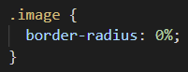
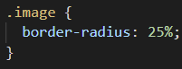
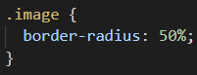
Image properties border-radius
There are other fun properties such as border-radius (it does not apply to images only) which we can use to make our image have rounded corners or be in the shape of a circle.

Slide 29
The Cascade of CSS
The cascade is an algorithm that defines how to combine property values originating from different sources. It lies at the core of CSS, as emphasized by the name: Cascading Style Sheets. Basically, it defines which rules get applied to our HTML. By understanding these rules, you will avoid many situations in which you don’t understand why your CSS isn’t working the way you intended it to work. We will cover three factors that the cascade uses to determine which rules get applied:
Specificity
Inheritance
Rule Order

Slide 30
Specificity
A CSS declaration that is more specific will take precedence over less specific ones. Inline styles, which we will go over more later on in the lesson, have the highest specificity compared to selectors, while each type of selector has its own specificity level that contributes to how specific a declaration is.
Specificity will only be taken into account when an element has multiple, conflicting declarations targeting it. An ID selector will always beat any number of class selectors, a class selector will always beat any number of type selectors, and a type selector will always beat any number of anything less specific than it.

Slide 31
Specificity
In the example, we see both rules using only class selectors, however, rule 2 is more specific because it is using more class selectors, so the color: blue; would take precedence.

Slide 32
Specificity
In the example, even though rule 2 is using more selectors, rule 1 is more specific because IDs are more specific than classes, so, we would see color: red; taking precedence.

Slide 33
Specificity
In this final example, we have both ID and class selectors in each example, so no rule is more specific in that way, but rule 2 has more class selectors than rule 1, so color: blue; would take precedence. Regardless, the background-color: green; of rule 1 would still apply as it does not conflict with any other declaration.

Slide 34
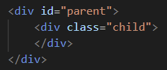
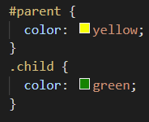
Inheritance
Inheritance refers to certain CSS properties that, when applied to an element, are inherited by that element’s descendants, even if we don’t explicitly write a rule for those descendants. Typography based properties (color, font-size, font-family, etc.) are usually inherited, while most other properties aren’t.
In the example, despite the parent having an ID and therefore a higher specificity, the child elements color: green; rule would apply as that declaration directly targets it, while color: yellow; from the parent is only inherited.

Slide 35
Rule Order
The third and final factor, the one that is taken into account after every other factor has been taken into account and there are still multiple conflicting declarations - rule order. The one which was last declared is the one that will be taken into account.
In this example, the <p> element has both the .first and .second class, so, there is no inheritance and there is no specificity, only rule order is left to be taken into account, and as .second is declared last, it will be taken into account.

Slide 36
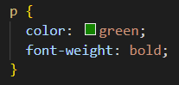
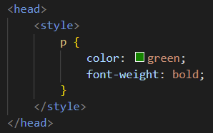
Adding CSS to HTML
We’ve gone over a lot of CSS, however, it is all pointless if we do not connect our CSS with our HTML, there are three ways to do it:
External CSS
Internal CSS
Inline CSS

Slide 37
External CSS
Note that we do not need to name the CSS file style.css, you can name it however you want to as long as it’s a .css file format. The most common names for CSS files are style.css and styles.css.
The reason why this is the most common method is because it keeps our HTML and CSS separated, which results in the HTML file looking smaller and cleaner, and it is also appliable easily to any other HTML pages.

Slide 38
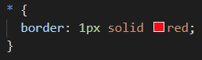
The Box Model
The Box Model states that every single element on the page is a rectangular box. These boxes can have more boxes in them or alongside them. The best way to see this is by giving each element a border via CSS.

Slide 39
The Box Model
There are many ways to manipulate the size of these boxes, and the space between them by using padding, margin and border. To sum it up briefly:
padding is the space between the edge of a box and the content inside of it.
margin is the space between a box and any others that sit next to it.
border adds space between the margin and the padding.

Slide 40
Inspect Element
Inspect Element is a developer tool offered by browsers to view and temporarily change the source code of any webpage. By using this tool, developers and designers can check and modify the front-end of any website. As you change the code, the browser keeps updating the webpage in real-time. Here are some examples of what you can do with Inspect Element:
Test out different resolutions
Perform live edits on a webpage
Use colorpicker to find value of a color you like
Change text to prank friends

Slide 41
Display property
Most of the elements you have learned so far about are block elements, which means their default style is display: block;. These elements appear on the page stacked atop one another with each new element starting on a new line below the previous element.
Inline elements, unlike block elements, do not start on a new line. They appear in line with elements they are placed beside. One good example of an inline element is the anchor tag. If you put an anchor tag in the middle of a paragraph, it will behave like a part of the paragraph, instead of starting on a new line. Also, the padding and margins of an inline element behave differently than a block element's padding and margins.
Inline-block elements behave like inline elements, except that they have padding and margins that behave like a block element’s ones. Inline-block is a good tool to know, but you will most likely use Flexbox if you want to line up a bunch of boxes, which we will cover later.

Slide 42
Display property
We can’t mention the display property without mentioning divs and spans. All the other HTML elements give meaning to their content - img element contains an image, paragraph element contains text, but divs and spans are just containers that can have anything inside of them. These elements are a lot more useful than they appear to be. We can use them to group elements under one parent for easier styling and positioning.
div is a block element by default, it is usually used as a container to group other elements. Divs allow us to divide the page into different segments and apply styling to them.
span is an inline element by default, it is usually used to group text content and inline HTML elements for styling when no other semantic HTML element is appropriate.

Slide 43
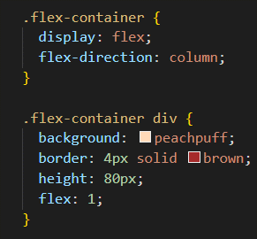
Flexbox
CSS

Slide 44
Flexbox
Flexbox is a layout model that allows elements to align and distribute space within a container. Using flexible widths and heights, elements can be aligned to fill a space or distribute space between elements, which makes it a great tool to use for responsive design systems.
Flexbox is not just a single property, but an entire toolbox of properties that you can use to put things where you want them to be. Some of these properties belong on the flex container and some on the flex items.
A flex container is any element that has the property display: flex; on it, while a flex item is any element that’s located inside the flex container.
Flex items can be both a flex item and a flex container, by that we mean - all flex items can also have the display: flex; property assigned to it, and then have its children arranged with flexbox. Creating and nesting multiple flex containers and items is the way that we will be building complex layouts.

Slide 45
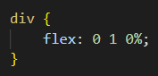
Flexbox
The flex declaration is a shorthand for 3 properties that you can set on a flex item. These properties affect how flex items size themselves within their container (shorthand properties are CSS properties that let you set the values of multiple other CSS properties simultaneously). In the example below, flex is a shorthand for flex-grow, flex-shrink and flex-basis.
The default values for these 3 properties are the ones you see in the example above: flex-grow is 0, flex-shrink is 1 and flex-basis is 0%. Very often you see the flex shorthand being defined with only value (flex: 1;), in which case that value is applied to flex-grow, while the latter remains default.

Slide 46
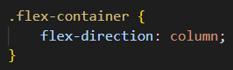
Flexbox - Axes
The way some rules work change depending on which direction you are working with. The default direction for a flex container is horizontal, or row, but you can set it to vertical, or column. The direction can be specified via CSS like so:
No matter which direction you’re using, you need to think of your flex-containers as having 2 axes: the main axis and the cross axis. It is the direction of these axes that changes when the flex-direction is changed. In most circumstances, flex-direction: row puts the main axis horizontal (left-to-right), and column puts the main axis vertical (top-to-bottom).

Slide 47
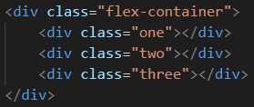
Flexbox - Axes
One thing to note is that in this example, flex-direction: column would not work as expected if we used the shorthand flex: 1; The divs collapse, even though they clearly have a height defined there. The reason for this is that the flex shorthand expands flex-basis to 0, which means that all flex-growing and flex-shrinking would begin their calculations from 0. Empty divs by default have 0 height, so for our flex items to fill up the height of their container, they don’t actually need to have any height at all.

Slide 48
Flexbox - Axes
The previous example is fixed by specifying flex: 1 1 auto, telling the flex items to default to their given height. We could also have fixed it by putting a height on the parent .flex-container, or by using flex-grow: 1 instead of the shorthand.

Slide 49
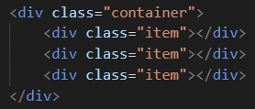
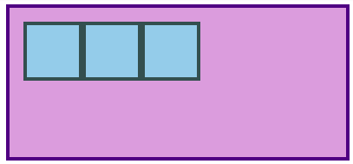
Flexbox - Alignment
So far everything we’ve touched with flexbox has used the rule flex: 1 on all flex items, which makes the items grow or shrink equally to fill all of the available space. Very often, however, this is not the desired effect. Flex is also very useful for arranging items that have a specific size. Let’s look at another example:

Slide 50
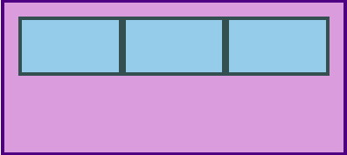
Flexbox - Alignment
If we add flex: 1; to the item class, we can see that the items expand to take the full width of the parent.

Slide 51
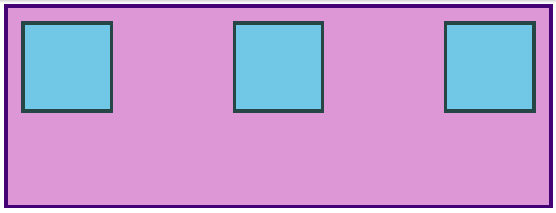
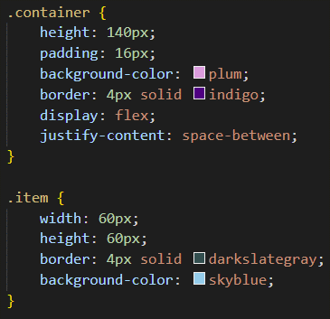
Flexbox - Alignment
However, what if we wanted the items to stay the original width, but distribute themselves differently inside the container? First we remove flex: 1; from .item and add justify-content: space-between to .container.

Slide 52
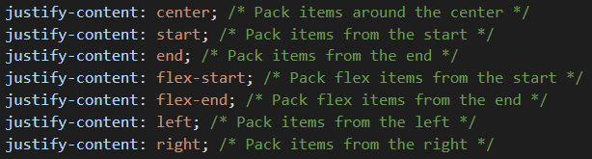
Flexbox - Alignment
justify-content aligns items across the main axis. Let’s look at a few values that you can use here:

Slide 53

Flexbox - Alignment
To change the placement of items along the cross axis use align-items. In the example below you can see how the items are placed in center along the cross axis by putting align-items: center; onto .container.
Because justify-content and align-items are based on the main and cross axis of your container, their behavior changes when you change the flex-direction of a flex-container. For example, when you change flex-direction to column, justify-content aligns vertically and align-items aligns horizontally.

Slide 54
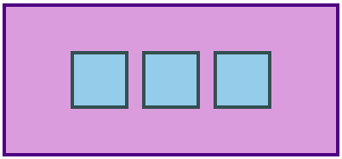
Flexbox – Gap
One more useful feature of flex is the gap property which is placed on flex containers. Setting gap onto containers adds a specified space between its flex items. It’s similar to adding a margin to the items themselves. Adding a gap of 16px on previous example produces the result below:

Slide 55
Assignment
alexteacher2907@gmail.com

Slide 56
Thank you for your attention!

